Slide 1
The Federal Funding Landscape:
What’s the Latest at NEH?
Joel Wurl
Sr. Program Officer
Division of Preservation and Access
National Endowment for the Humanities
Notes:
How does this really work?

Slide 2
NEH is an independent federal agency created in 1965. One of the largest funders of humanities programs in the U.S., including archival projects.
Core Mission:
  Strengthen teaching and learning in the humanities in schools and colleges across the nation
  Provide opportunities for lifelong learning through public programs
  Facilitate research and original scholarship
  Preserve and provide access to cultural resources
  Support the state humanities councils throughout the country
  Strengthen the institutional base of the humanities
  Advance humanities scholarship, education and programming through technology

Slide 3
NEH Programs & Allocations
NEH 2014 Budget
$146,021,000
Division of
Education
$13,237,000
Division of
Public
Programs
$13,654,000
Division of
Research
$14,752,000
Division of
Preservation & Access
$15,426,000
Office of
Challenge
Grants
$8,357,000
Matching
Federal/State
Partnership
$42,435,000
Office of Digital
Humanities
$4,388,000
Special Initiatives
& Programs
$3,494,000
Notes:
FY 2011 Appropriation: $154,690,000 ($16,500,000 for Preservation and Access)
FY 2012 Appropriation: $146,021,000
($15,176,000 for Preservation and Access)
FY 2013 Request: $154,255,000 ($15,700,000 for Preservation and Access)
As a federal agency, the Endowment is supported by taxpayer funds. We take very seriously our role as stewards of public money. In fiscal year 2012, the NEH programming budget was $146 million dollars. The Endowment’s work is run through eight divisions. I will run through them very briefly, demonstrating each division’s work by noting a few recent grants to local institutions.
NEH’s Overall Budget (2012): US $146 million
~$28M for administration (salaries, rent)
$40M distributed to 56 state and territory-based humanities councils
Remaining $76M given out as direct grants to US institutions—particularly to universities, libraries, and museums—and to individual scholars
A couple of points:
The Office of Challenge Grants provides matching funds; these are separate from the rest of the NEH budget.
The single largest allotment goes through the Federal/State Partnership to the 56 state and jurisdictional humanities councils.
The Special Initiatives funds provide grants directly to applicants and to grant recipients through the other divisions. These funds typically enhance a particular emphasis or program by each Chairman. In 2010, much of these funds were related to the We the People initiative, begun by the previous chairman, Bruce Cole. The current chairman, Jim Leach, has created a “Bridging Cultures” initiative, and some of these funds have gone to that set of programs.

Slide 4

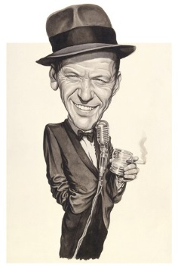
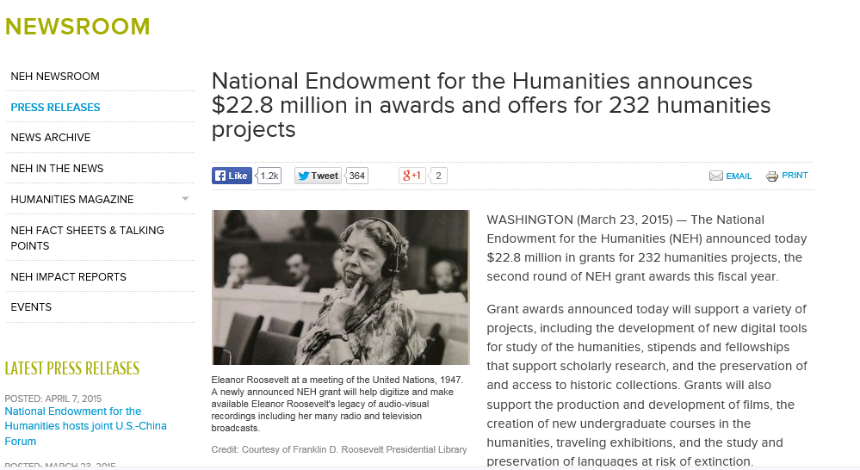
“Start Spreading the News!”

Slide 5
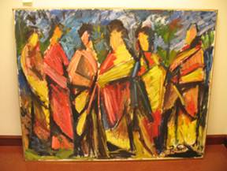
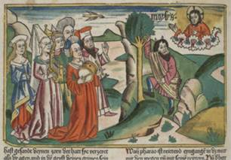
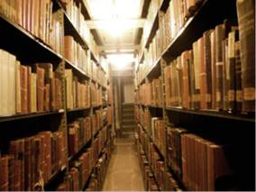
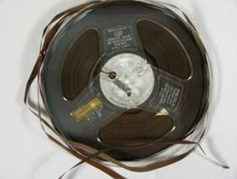
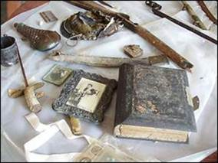
Humanities Collections and Reference Resources
Implementation
Foundations
Up to $350,000 for up to three years
Supports extended planning and pilot efforts
Up to $40,000 for up to two years
Next Deadline July 21, 2015

Slide 6

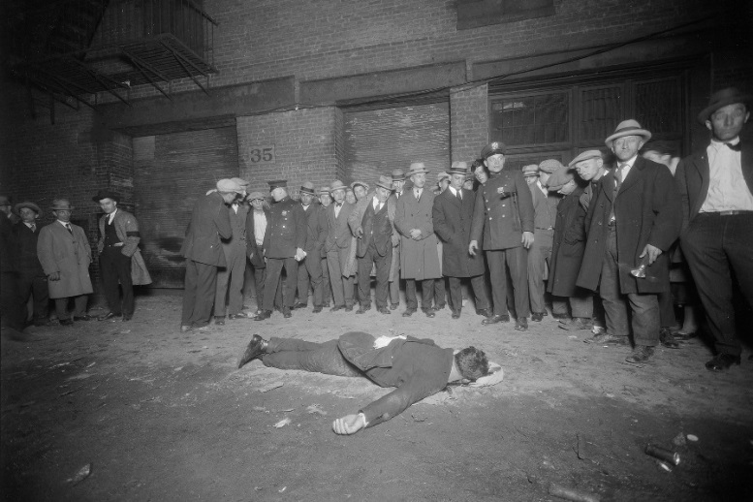
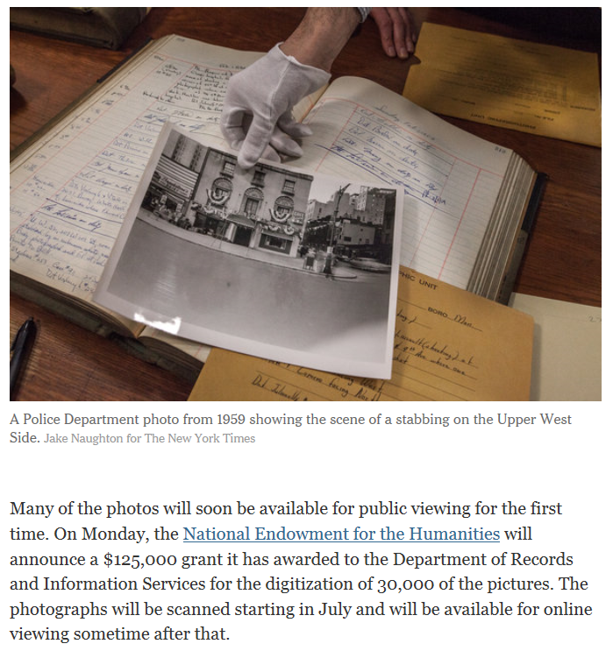
“I want to Wake up in a City that Doesn’t Sleep!”
New York City Department of Records & Information Services
Dusting Off a Police Trove of Photographs to Rival Weegee’s
MARCH 20, 2015
Project Title: New York City Police Department Photograph Collection, 1914-1975, Preservation and Access Project
Project Description: Rehousing, describing, and digitizing a collection of criminal justice photographs taken by the New York City Police Department from 1914 to 1975.

Slide 7
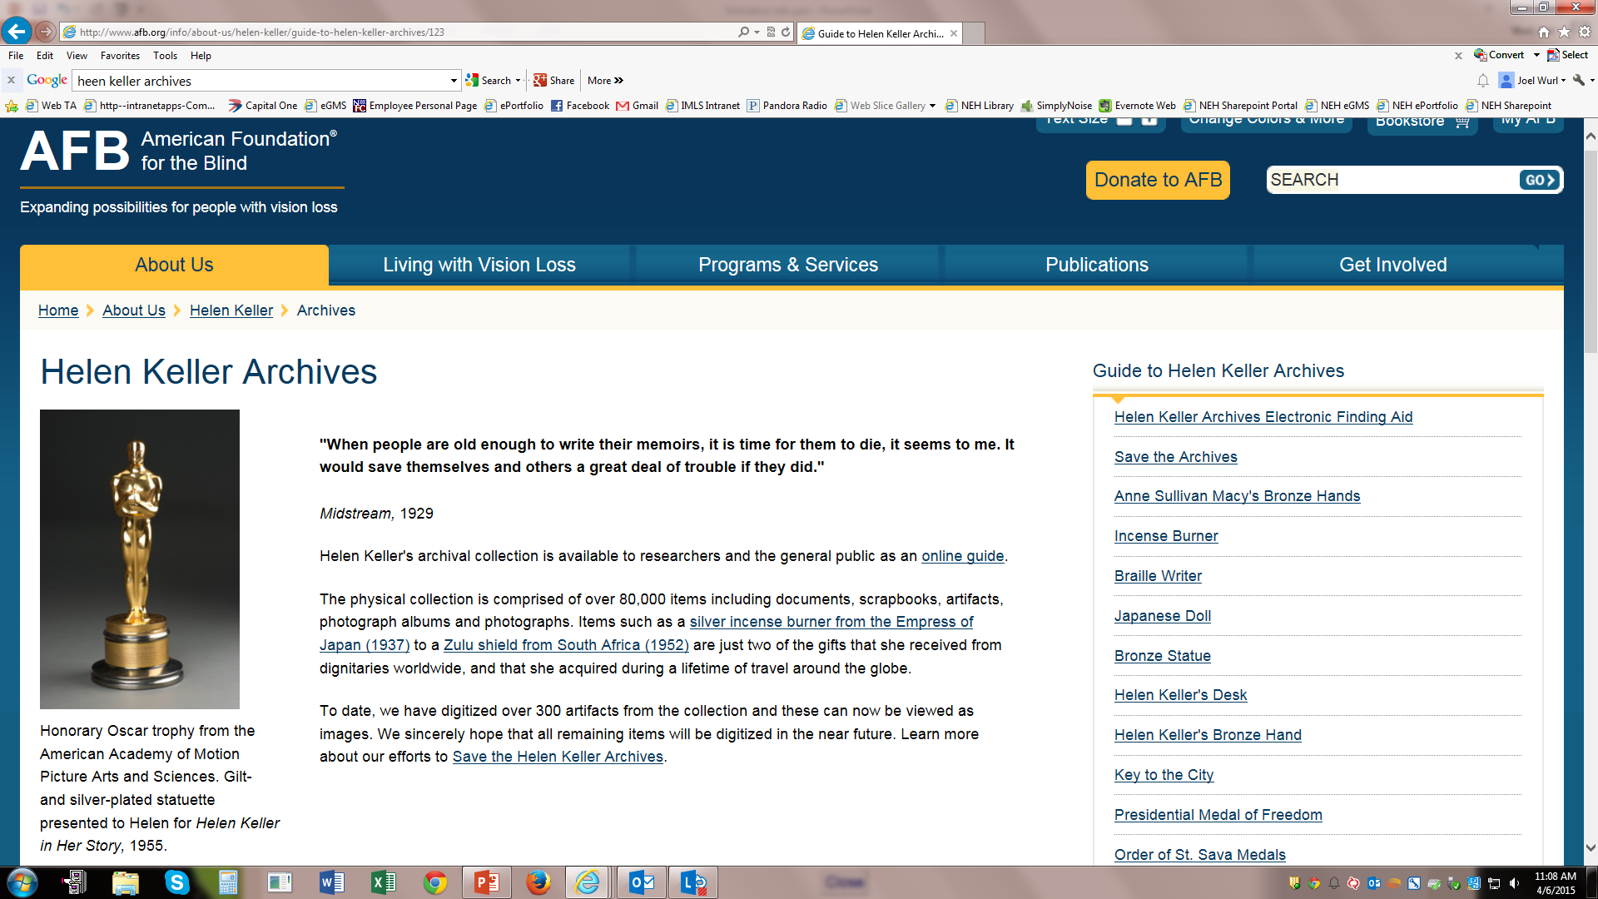
“’A,’ Number One!”
Project Title: Digitization of the Helen Keller Archival Collection
Project Description: The digitization of the Helen Keller papers, comprising 80,000 items
(150,000 page images), enabling free online access to the collection.

Slide 8
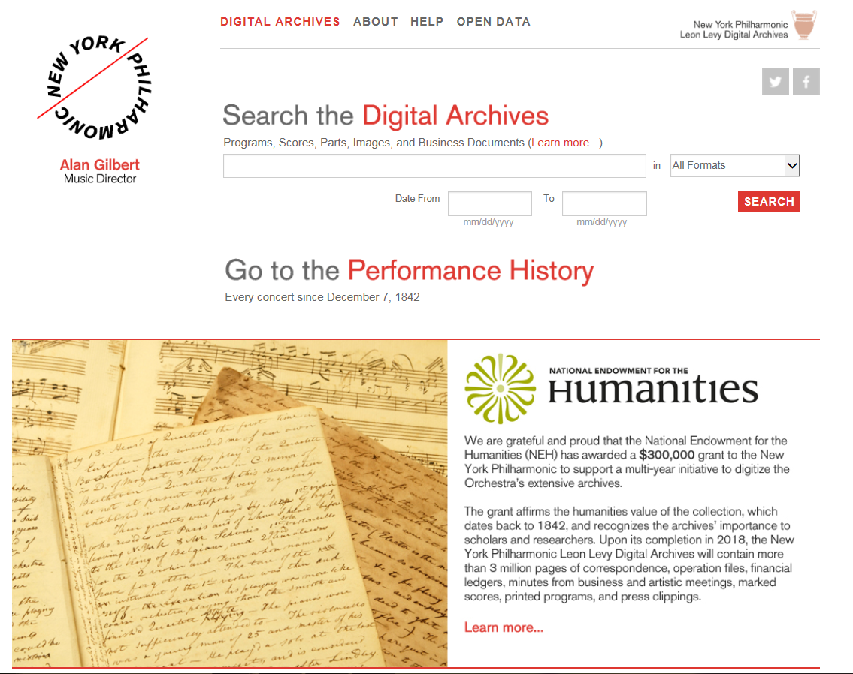
“King of the Hill!”
Project Title: New York Philharmonic Digital Archives Project 1842-1943
Project Description: The digitization of over 400,000 pages of the New York Philharmonic's institutional records and 2,100 bound musical scores documenting the history of the organization from 1842 to 1943.

Slide 9
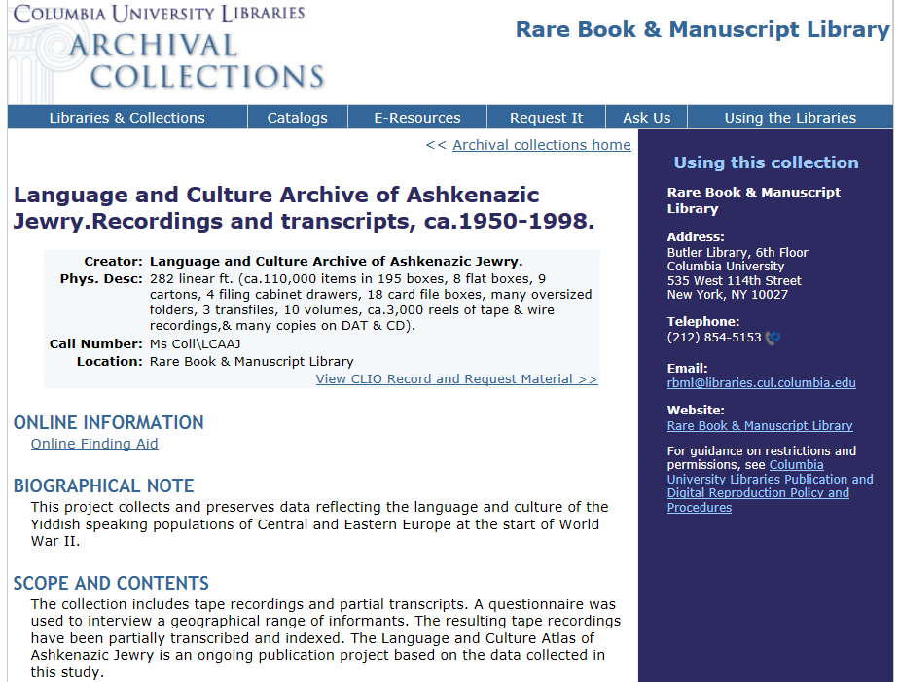
“Top of the Heap!”
Project Title: Language and Culture Archive of Ashkenazic Jewry: Digitizing the Data
Project Description: The digitization of field notes and supplemental surveys gathered
during research for the Language and Culture Atlas of Ashkenazic Jewry, documenting
Yiddish speakers in Europe and the Americas from the 1960s to the 1970s.

Slide 10
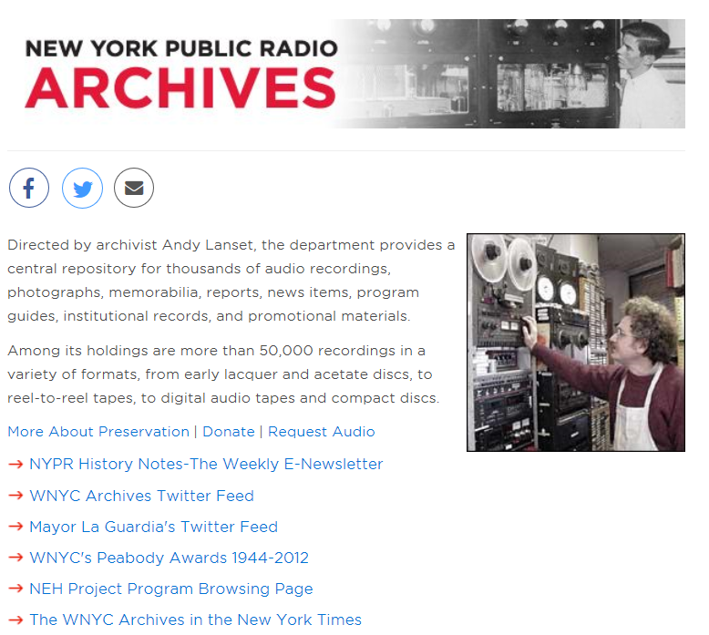
“Right Through the
Very heart of It”
Project Title: WNYC Audio Preservation and Access Project (Part II)
Project Description:
The digitization of up to 680 hours of radio broadcast recordings (1,360 individual recordings) from 1938 to 1970 pertaining to the political, social, and cultural history of New York.

Slide 11
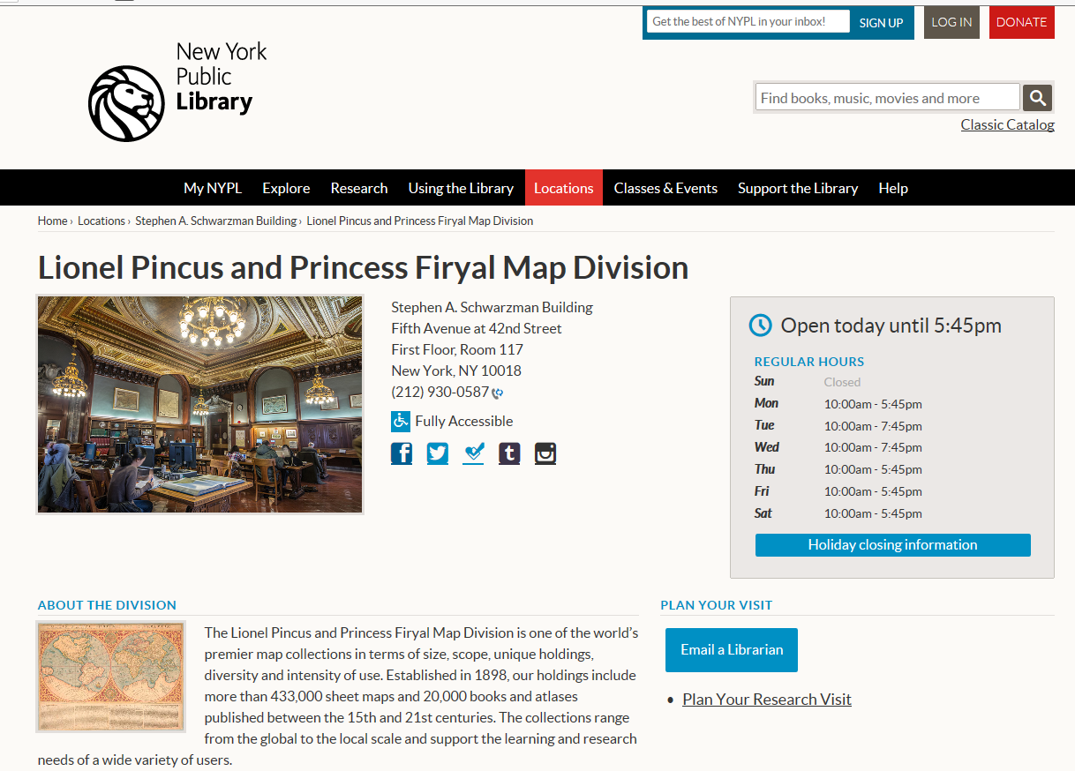
“Top of the List!”
Project Title: Mapping the Nation, 1565-1899
Project Description: Cataloging, conservation, and digitization of approximately 4,000
single sheet maps dating from the 16th to the 19th century that document the whole of the
United States at various periods in the nation's history, as well as regional and state maps,
and detailed maps of counties, towns, and localities.

Slide 12
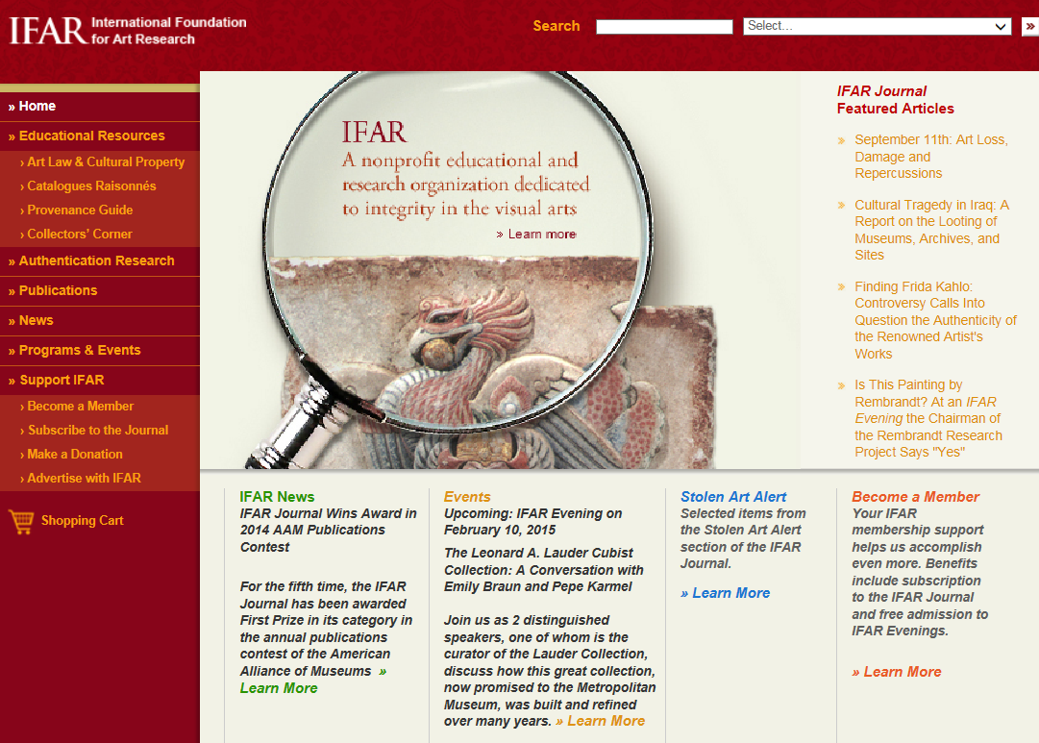
“Gonna Make A
Brand New Start of It”
Project Title: Enhancements to IFAR's Catalogues Raisonnés Database
Project Description: Planning for enhancements to an existing database for art historical research, and development of a pilot to test usability of the enhancements. The current database, Catalogues Raisonnés, contains records to about 3,600 published volumes on approximately 2,300 artists, covering all artistic styles from antiquity to the present, and serves scholars and general users.

Slide 13
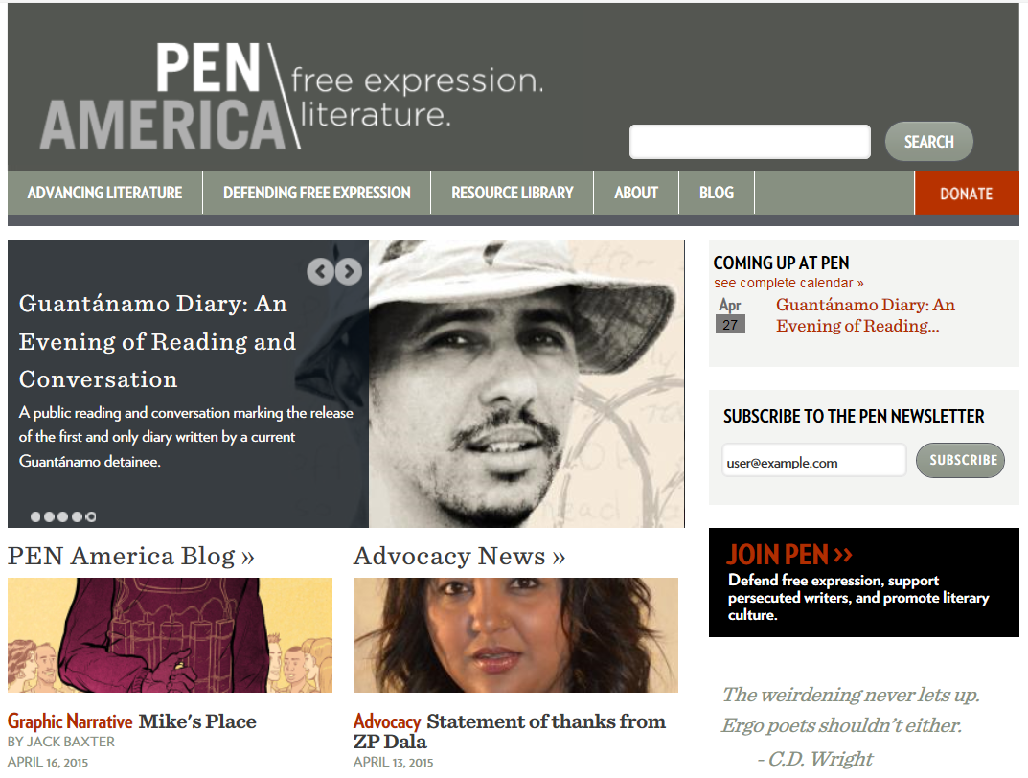
“’A, Number ONE!”
Project Title: Digital Archive of Free Expression
Project Description: Digitization of 1,200 hours of audio and video recordings gathered from 800 events sponsored by the PEN American Center, documenting the organization's mission to advance freedom of expression worldwide.

Slide 14
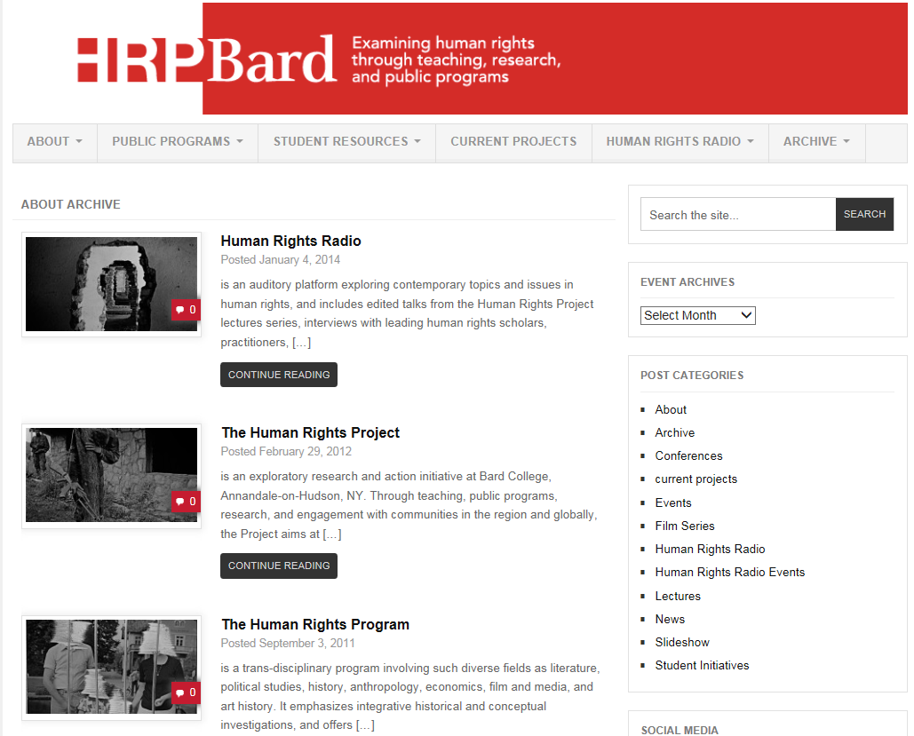
“These Little Town Blues
are Melting Away!”
Project Title: Milosevic Trial Public Archive
Project Description: Planning for a digital archive of 1,800 hours of streaming and downloadable video, expert reports, and complete transcripts of the trial of former Serbian President Slobodan Milosevic at the United Nations war crimes court in the Hague.

Slide 15

Research and Development
Research Fields and Topics
accessibility for the disabled
appraisal and selection
cataloging and description
digital forensics
digital preservation
disaster preparedness and emergency response
humanities research data management and curation
indigenous cultural heritage practices
knowledge organization
linked open data
material analysis
metrics for evaluating use of humanities materials
preventive conservation
textual encoding
visualization
    Tier I: Up to $75,000 for up to 2 years
      Planning and preliminary work for large-scale research and development projects; and
      Stand-alone basic research projects, such as case studies, experiments, or the development of iterative tools
    Tier II: Up to $350,000 for up to 3 years
      Development of standards, practices, methodologies, or workflows for preserving and creating access to humanities collections; and
      Applied research

Slide 16
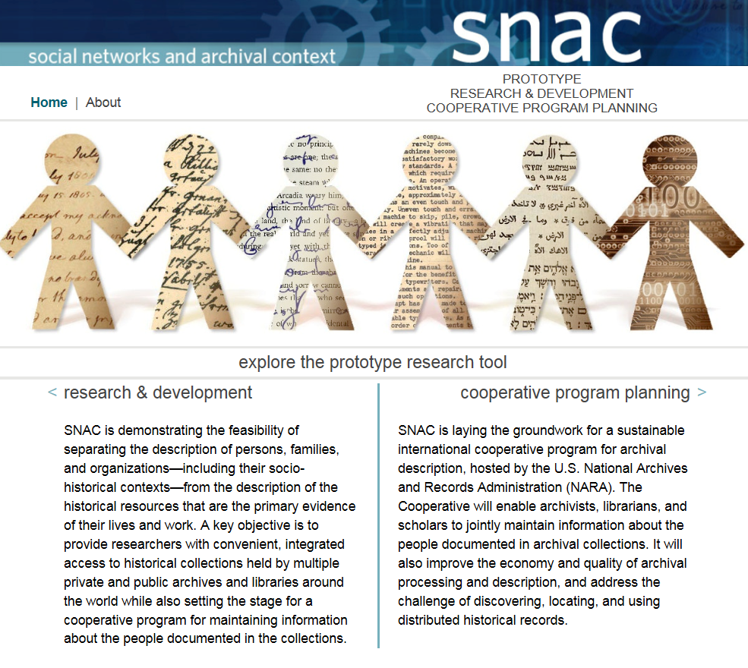

Slide 17

Education and Training
  Supports programs that meet national or regional educational needs of cultural heritage preservation for early- and mid-career, including Master’s degree programs and workshops.
  Deadline: May 5, 2015

Slide 18
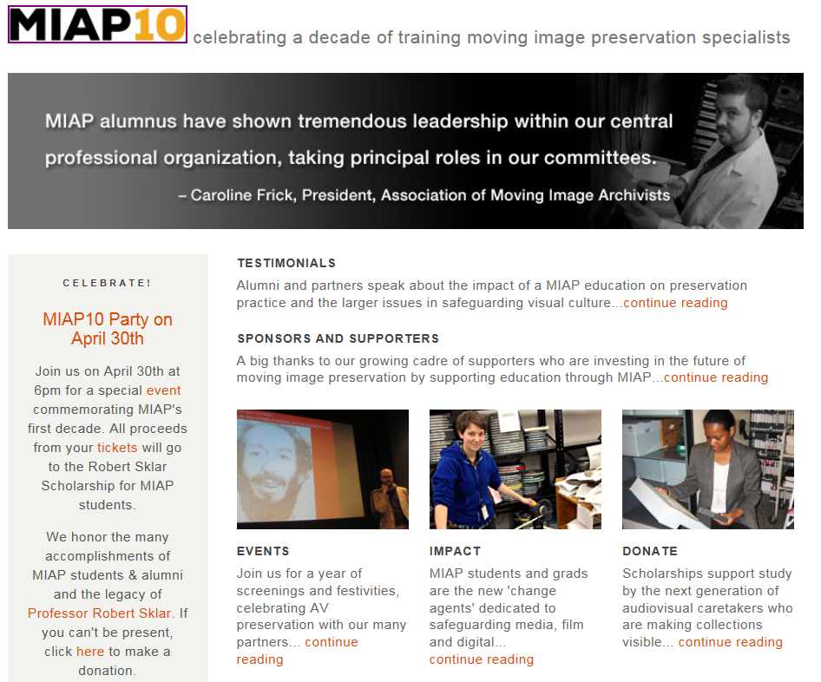
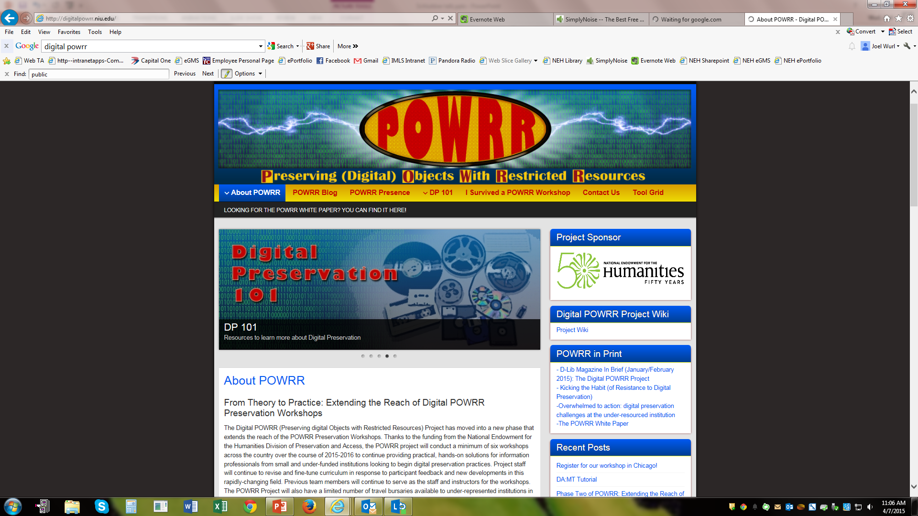

Slide 19
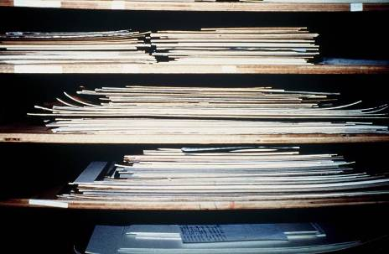
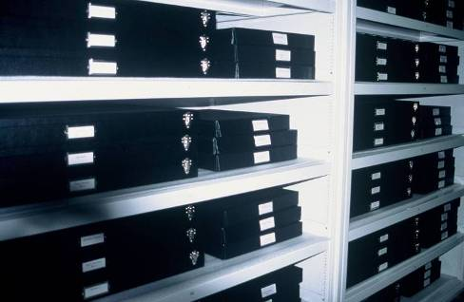
Preservation Assistance Grants for Smaller Institutions
Eligible activities include:
General preservation assessments and long-range planning
Consultations with professionals to address a specific preservation need
Purchase of storage furniture and preservation supplies
Purchase of environmental monitoring equipment
Education and training (disaster recovery, collections care, standards and best practices for digital stewardship).
Awards up to $6000, no cost share. Next Deadline: May 5, 2015
Notes:
Preservation Assistance Grants
These are small grants for up to $6000, easy to write (5 pages), there’s no cost share, and, of late, we fund approximately 25% of the applications we receive, (compared with a lower funding percentage -- 15%-- for other categories). The program funds -- General preservation assessments; consultations with professionals to address a specific preservation need; Purchase of storage furniture and preservation supplies; Purchase of environmental monitoring equipment; Education and Training (disaster recovery, collections care, standards and best practices).
In short, PAGs will enable your institution to plan for the long-term care of a collection, be it art or artifacts, an archive or a library.

Slide 20
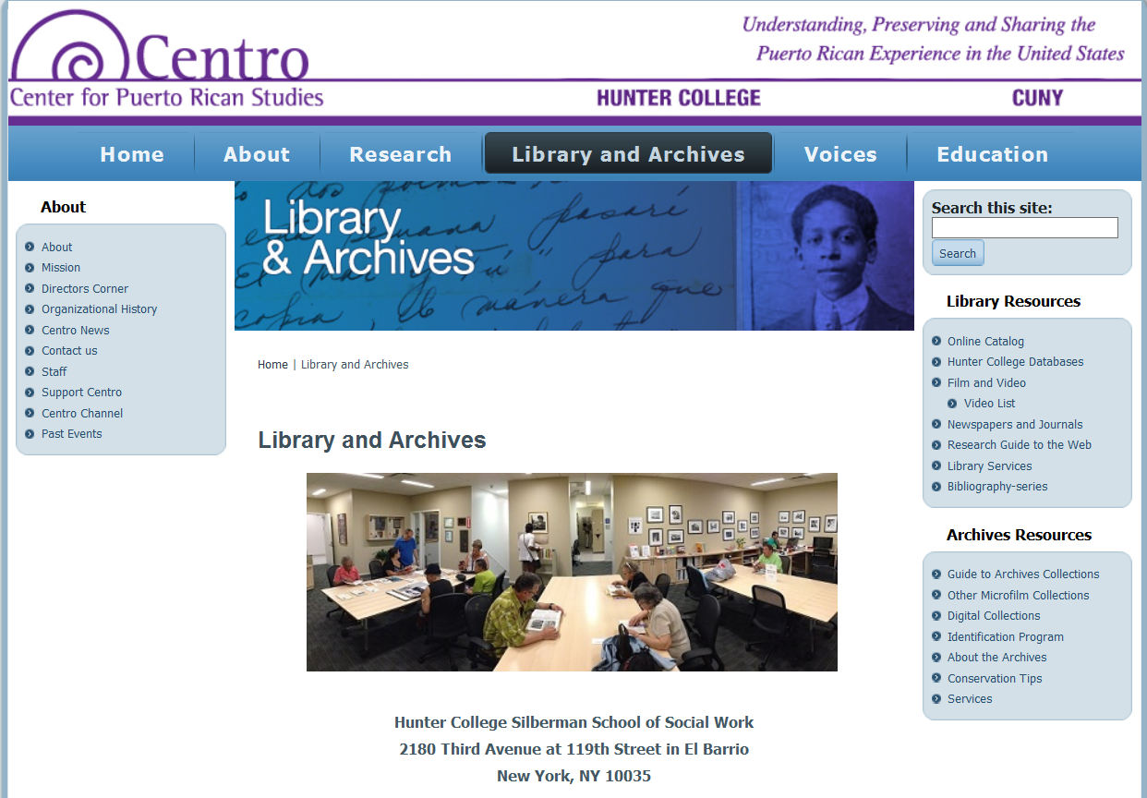
Project Title: The Archives of the Puerto Rican Diaspora Audiovisual Collection Preservation Assessment
Project Description: The preservation assessment of the Center for Puerto Rican Studies, Library and Archives Unit’s audiovisual holdings, which document the Puerto Rican migration and cultural experience in the United States from the 1930s to the present, including prominent writers, musicians, politicians, community activists, and labor leaders.

Slide 21
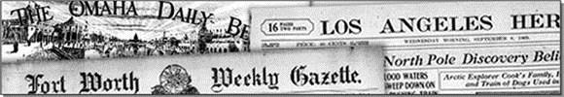
National Digital Newspaper Program
Chronicling America
NDNP is creating a national, digital resource of historically significant newspapers published between 1836 and 1922, from all the states and U.S. territories. This searchable database will be permanently maintained at the Library of Congress (LC) and be freely accessible via the Internet. An accompanying national newspaper directory of bibliographic and holdings information on the website directs users to newspaper titles available in all types of formats.
http://chroniclingamerica.loc.gov/

Slide 22
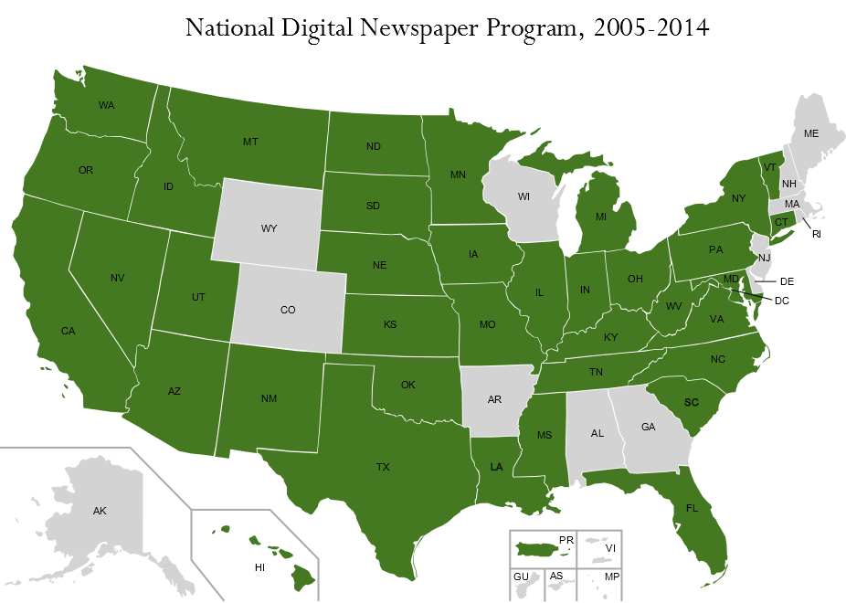

Slide 23
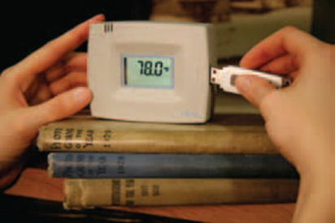
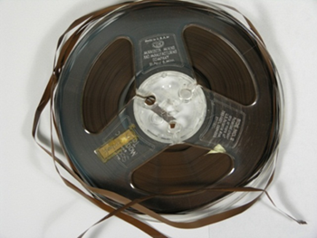
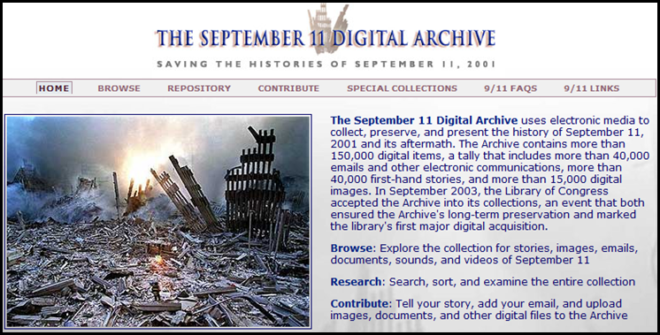
Division of Preservation & Access
Strategic Interest Areas
Preventive Conservation
Audiovisual Collections
Digital Stewardship

Slide 24
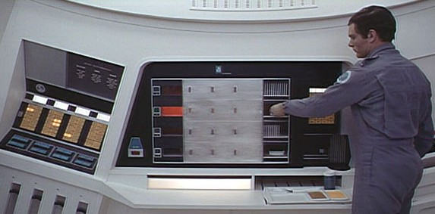
Office of Digital Humanities
Encourages innovations in the digital humanities through research that brings new approaches or documents best practices; creation of digital tools for preserving, analyzing, and making accessible digital resources; and examination of the philosophical implications and impact of emerging technologies.
Digital Humanities Start Up Grants
DH Implementation Grants
Institutes for Advanced Topics in the Digital Humanities
Bilateral Digital Humanities Program with German Research Foundation (DFG)

Slide 25
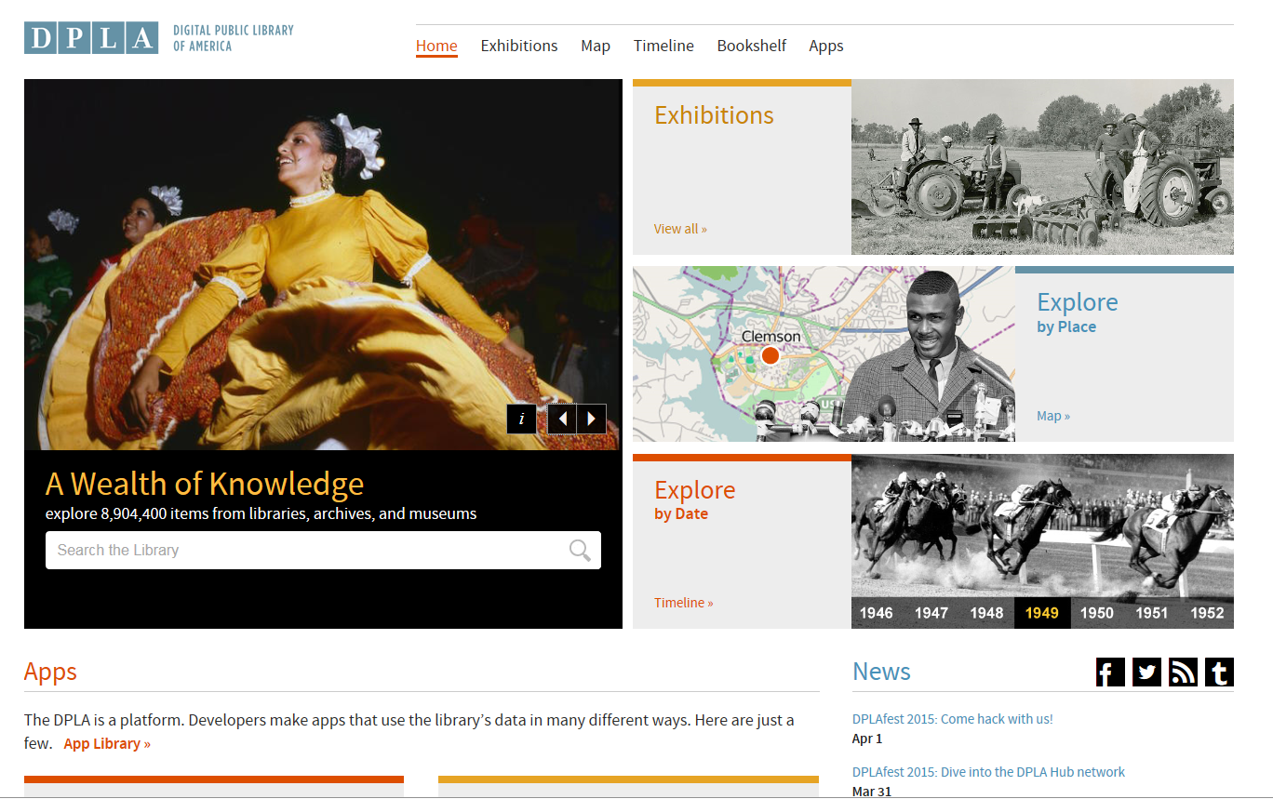

Slide 26

Anything new on the menu?

Slide 27
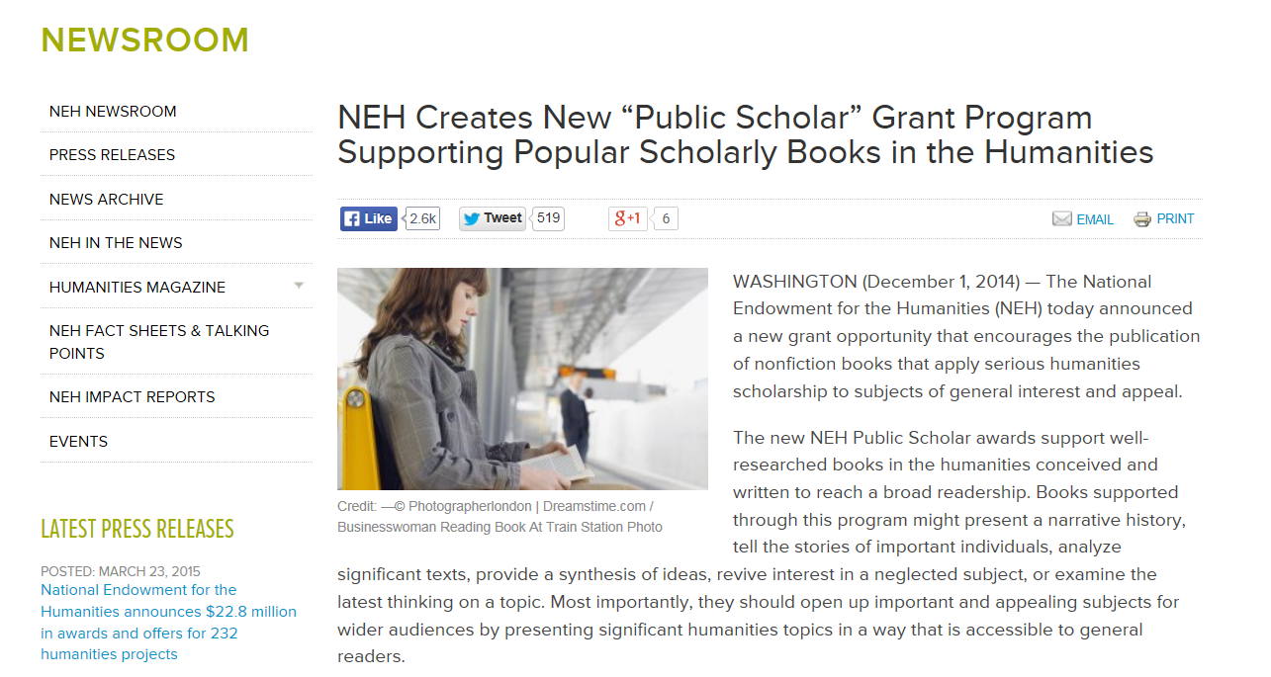
The Common Good:
The Humanities in the Public Square

Slide 28

Division of Public Programs:
Digital Projects for the Public
DISCOVERY: Up to $30,000
  designed to fund the exploratory stages of a digital project.
  Activities must include: scholarly consultation, refinement of the humanities themes, analysis and development of potential platforms.
PROTOTYPING: Up to $100,000
  supports the creation of a proof-of-concept prototype.
  Other activities can include: further refinement of humanities content, further consultation with scholars and digital media experts, scripting, user interface and backend development, audience evaluation and testing.
PRODUCTION: Up to $400,000
  supports the final stages of a digital project
  Activities can include: prototype refinement and beta testing, audience outreach, project distribution and related public programming.
  DEADLINE: June 10, 2015
Supports:
  Games
  (Curated) Websites + Online Experience
  Mobile Applications + site-specific storytelling
  Virtual reality environments
  Transmedia storytelling

Slide 29

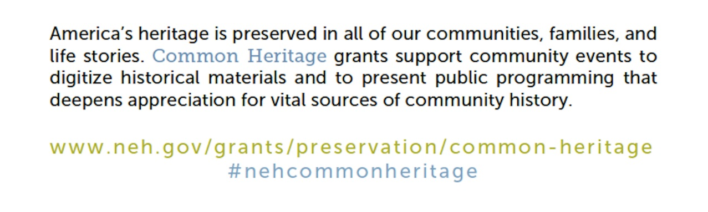
Award Amount: up to $12,000
Deadline June 25, 2015 for Projects Beginning January 2016

Slide 30
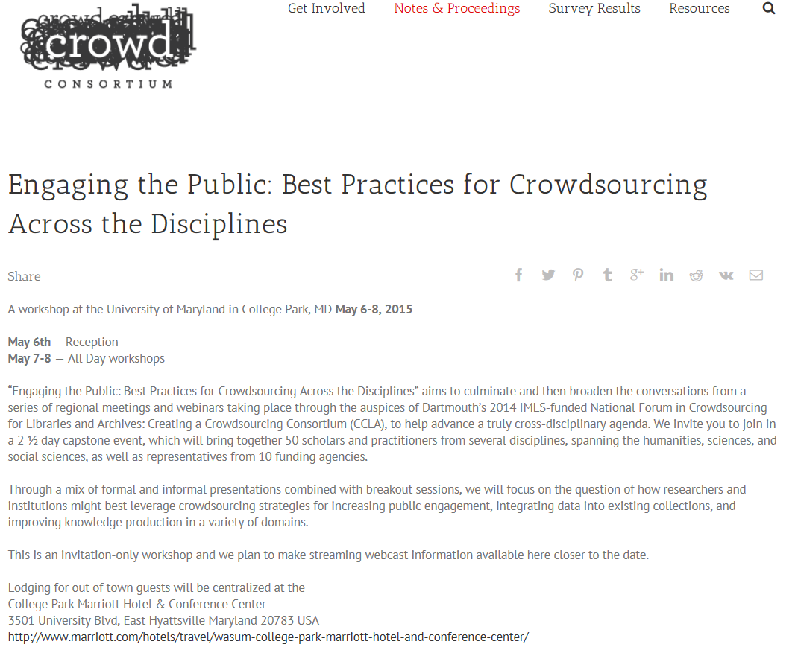
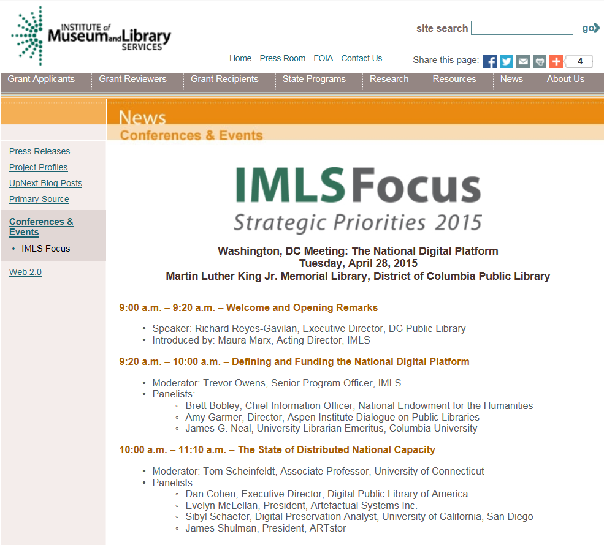
Coming Very Soon….

Slide 31
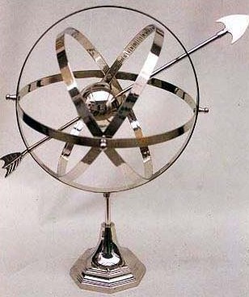
Onward Trajectories
Collaboration & Interdisciplinary Engagement
Audiovisual Resources – Hidden and Essential
Digital Stewardship & Sustainability of Legacy Projects/Resources
Spatial Analysis & Representation
Greater Democratization of Content & Delivery – Open Access
International Partnerships and Approaches
Notes:
we feel quite confident that as HCRR looks ahead, we’ll see continuing movement toward collaboration in its many forms. [“collaboration”] We take care to advise prospective applicants of the wisdom of having both the technical capacity and humanities grounding to execute what can often be highly complex projects in this grant category. [“a/v”] Other emphases we foresee include responding to a growing need to improve the care and availability of some of the most hidden collections of all, sound recordings and moving images, and our guidelines for the coming year will express added encouragement for such proposals. [“digital pres.”] We will also be pointing applicants to the increasing importance of ensuring that significant content in digital form is available for enduring use – a special encouragement also in our Research & Development program and, as Nadina has discussed, a matter of critical national attention. Fully 100% of the projects recommended this year involve digital methods or outcomes; it has become the way cultural heritage institutions and reference resource creators do business. [“beyond digital”] If this suggests we are somehow entering a “post-digital” age, where interest shifts from discovering and reading information online to performing computational analysis of it (such as text mining, visualization, or forensics), we want this grant program to help guarantee that core humanities collections and resources are there to be used. Wherever current trends lead,

Slide 32
It’s up to You….!
In order to receive a grant, you must ASK
Read the guidelines, and follow the prescribed format
Review sample proposals
Confer with a program officer
Plan ahead for intellectual development, collaborative commitments, and support letters
Write for multiple audiences (not all readers are specialists in your field); avoid excess jargon
Submit a draft
If turned down, ask for comments
If ratings and comments are encouraging, make adjustments and reapply

Slide 33
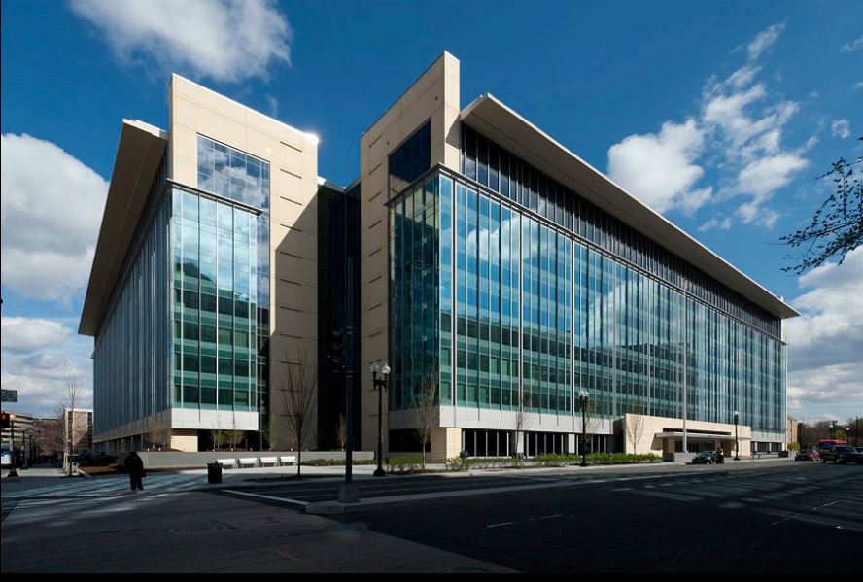
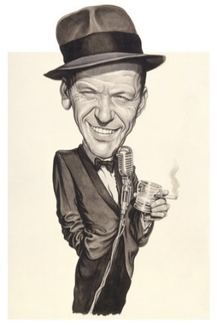
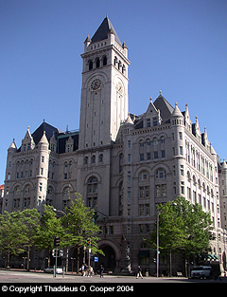
  Many Thanks!
  Joel Wurl
  Sr. Program Officer
  Division of Preservation & Access
  National Endowment for the Humanities
  400 7th St. SW
  Washington, DC 20506
  (202) 606-8252
  jwurl@neh.gov
Connect With Us
  YouTube
  Twitter
  Facebook

